Slide 1
Coop 101 – Week 4
Career Planning
Brittany Root, M.Ed, PHR
Assistant Teaching Professor
Steinbright Career Development Center
Pronouns: she/her/hers
bhr26@drexel.edu

Slide 2
Today’s Agenda:
Interview Question
Steps for Career Planning/Creating a Professional Development Plan
Workplace TIP
Institutional Equity and Inclusive Culture Guidance
Job Description Assignment Due Next Week

Slide 3
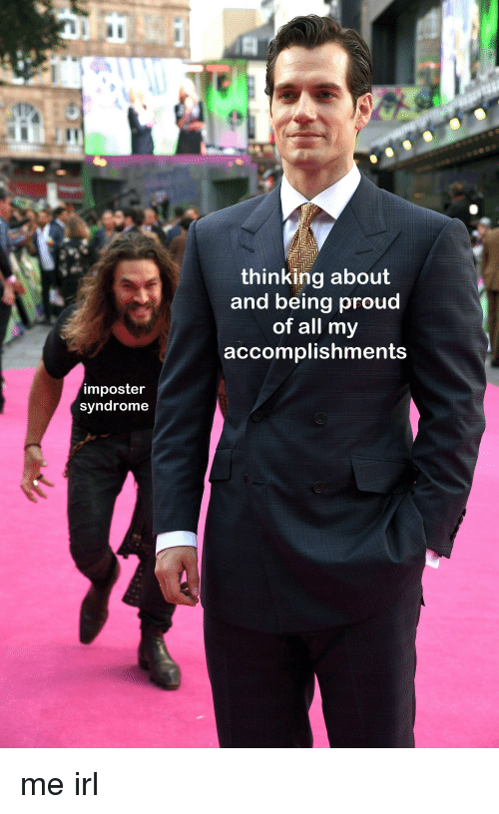
Interview Question:
What is your proudest accomplishment?
Notes:
Be intentional about what the accomplishment you choose to highlight says about you!
Do you want to show a soft skill (hard worker, persistent, team oriented)? Or do you want to highlight a particular hard skill (won a hackathon, placed in a business case competition?)
If you choose to highlight something less directly related, such as winning a sports competition, then use the opportunity to highlight a soft skill that it took to accomplish this. For example: My proudest accomplishment was winning state with my high school volleyball team. I am proudest of this moment because I maintained a rigorous personal practice schedule to advance my skills, and our team had great communication and teamwork throughout the season”

Slide 4
Rate the Response Below – Scale of 1 to 5
“My proudest accomplishment is that I won districts as a starting forward with my high school basketball team”
Why did you give it that rating?

Slide 5
The key is to explicitly make the accomplishment relevant to the employer!
Better Response:
“Senior year of high school, I was the starting forward on my high school basketball team when we won districts. I am proud of this accomplishment because we did it as a team. We had great communication and worked together throughout the season to celebrate each other’s successes and to continue to improve. I am also proud of my dedication to practice and growth. I never missed a day of practice throughout my high school career”.

Slide 6
Think about one accomplishment you could highlight to an employer.
Find another student to talk with about your accomplishment.
Discuss!

Slide 7
Career Planning/Creating a Professional Development Plan
1. Identify Personal Values and Interests
2. Find Job Opportunities that Match your Interests
3. Assess Your Own Skills
4. Goal Setting Conduct a Skills Gap Analysis and Set Smart Goals to develop needed skills
5. Market Yourself through Resume & Interview to Achieve Career Goals
Notes:
These are the steps we will review in this class to set career related goals/to develop a professional development plan to ensure you identify jobs that align with your interests/values and to ensure you develop necessary skills to achieve those related career goals.

Slide 8
Step One: Identify Personal Values and Interests

Slide 9
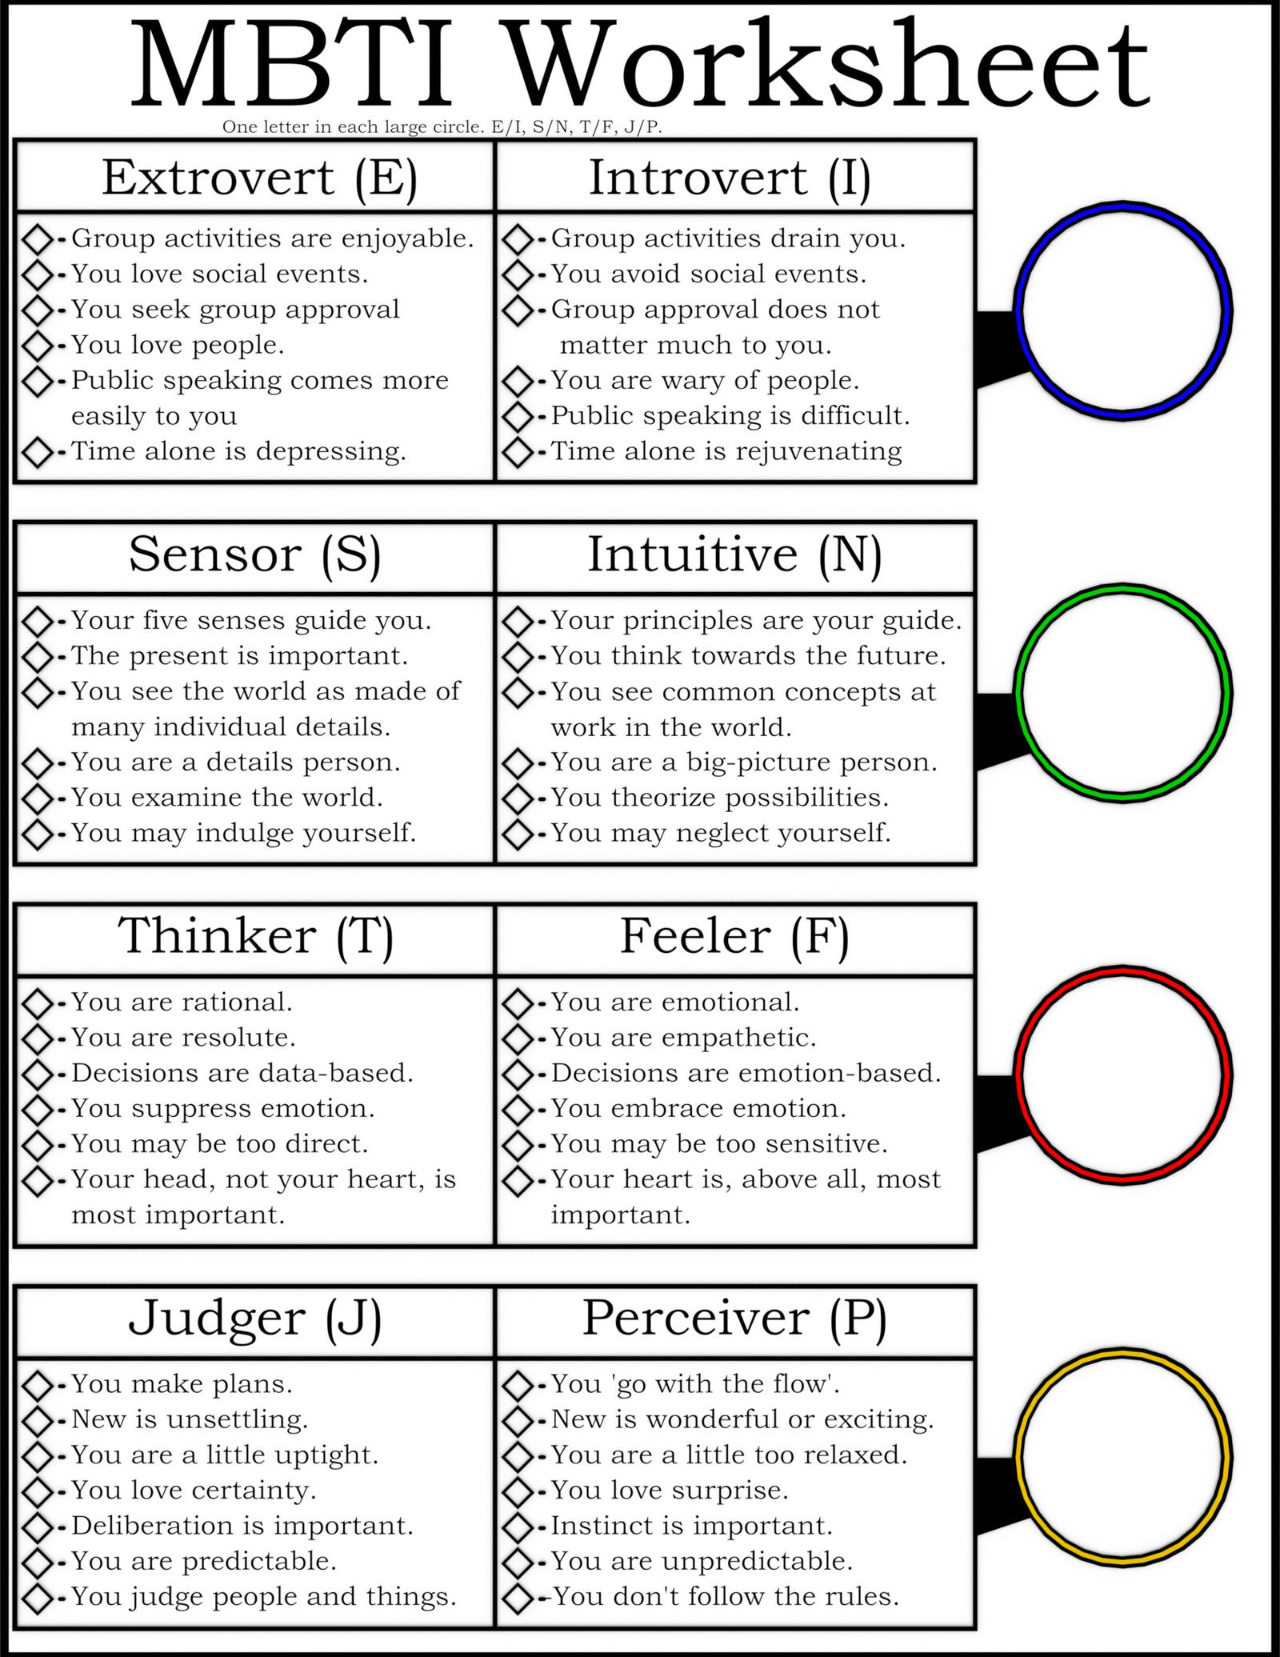
Assess Your Values & Interests
Notes:
There is conflicting evidence about the accuracy of the MBTI or type focus assessments, but it can be incredibly helpful to assess yourself/reflect on some of the personality traits above, so you know what type of a workplace or day to day work will be a good fit for your personality.
For example: If you fall on the more introverted side of the spectrum, you may like to do work that is more extroverted in nature (meeting with clients), but it may take more energy/be more draining for you to do that work, so you may need a position that also has a good balance of independent or administrative work, so the majority of your work day isn’t devoted solely to tasks that involve high levels of interaction with others.
Think through each of the rows above and decide which column your personality more closely aligns with. For example, I am an ISTJ.

Slide 10
Identify your MBTI categories
Extrovert (E) or Introvert (I)
Sensor (S) or Intuitive (N)
Thinker (T) or Feeler (F)
Judger (J) or Perceiver (P)
2. Find a student to talk to about: How one of your personality traits will impact your work life.
Discuss!

Slide 11

What’s Important To You?
Knowledge
Pursuit of knowledge & Understanding
Security
Job and compensation stability
Change & Variety
Work activities that frequently change
Work with Others
Work as a team towards common goal
Help Society
Improve the world in which we live
Work Alone
Projects by myself
Supervision
Responsible for the work of others
Influence People
Influence attitudes & opinions of others
Public Contact
Day to day interactions with public
Routine
Work routine & duties are predictable
Help Others
Direct involvement in helping people
Aesthetics
Studying & appreciating beauty of things, ideas, etc.
Make Decisions
Power to decide courses of action & policies
Competition
Engage in activities that pit my abilities against others
Work Under Pressure
Situations were time & pressure is prevalent
Artistic Creativity
Creative artistic expression
General Creativity
Create programs, materials, organizational structures
Notes:
When deciding on a career path or type of position to pursue, assessing what is important to you related to the type of work you will do day to day can be very important.
Examples:
If you know you are someone who gets bored if there is repetition in the work you do, then “change and variety” would be critically important aspects of a job you pursue more long term.
If predictable and consistent tasks are something you like then “routine” would be a trait you would want to find the type of work you do day to day
Is it important you be able to be creative in your day to day work, either general creativity or artistic creativity?
Do you thrive in a competitive environment or is it important that your work be free of competition?

Slide 12
Step Two: Finding Job Opportunities

Slide 13
How to Find Job Descriptions
ES&P Archives
Handshake
LinkedIn
Indeed
What to Review in JDs
Review Qualifications to Identify:
Hard Skills
Soft Skills
Educational Requirements
Notes:
Search potential job descriptions to practice identifying key aspects of the day-to-day work/qualifications and skills that are a good fit for positions of interest, and assess whether the positions closely align with your interests, values, skills, qualifications.

Slide 14
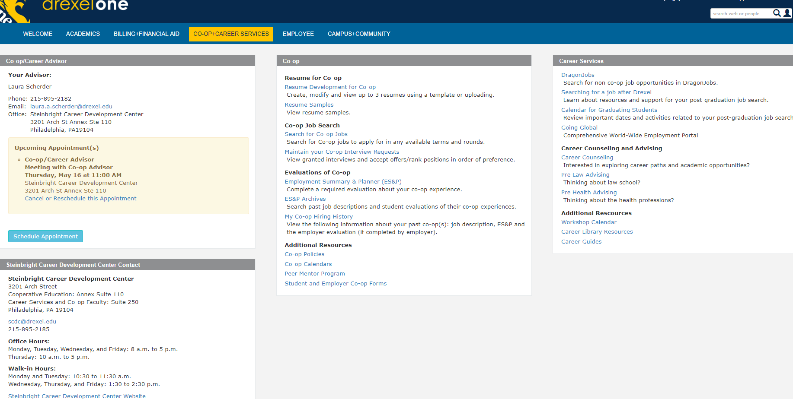
ES&P Archives
Notes:
The ES&P Archive through Drexel One will allow you to get a feel for companies and positions that Drexel students have experience with.
While Co-op may seem far off, it is important to start to think about what type of companies and what type of positions you may want to apply to and for. As long as you have access to Coop & Career services tab in DrexelOne you can access an archive of positions that student shave held during the past 6+ years. The next four slides walk you through gaining access to the archive.
You should start to review job descriptions here to start getting a sense of the types of duties and responsibilities you will be required to perform while on coop. You can also see some of the companies who have hired Drexel students and their locations. It is important to start getting a sense of where your industry is going (both physically and skill based). Once you identify trends in skills companies are looking for you can better build your resume to include these skills.

Slide 15
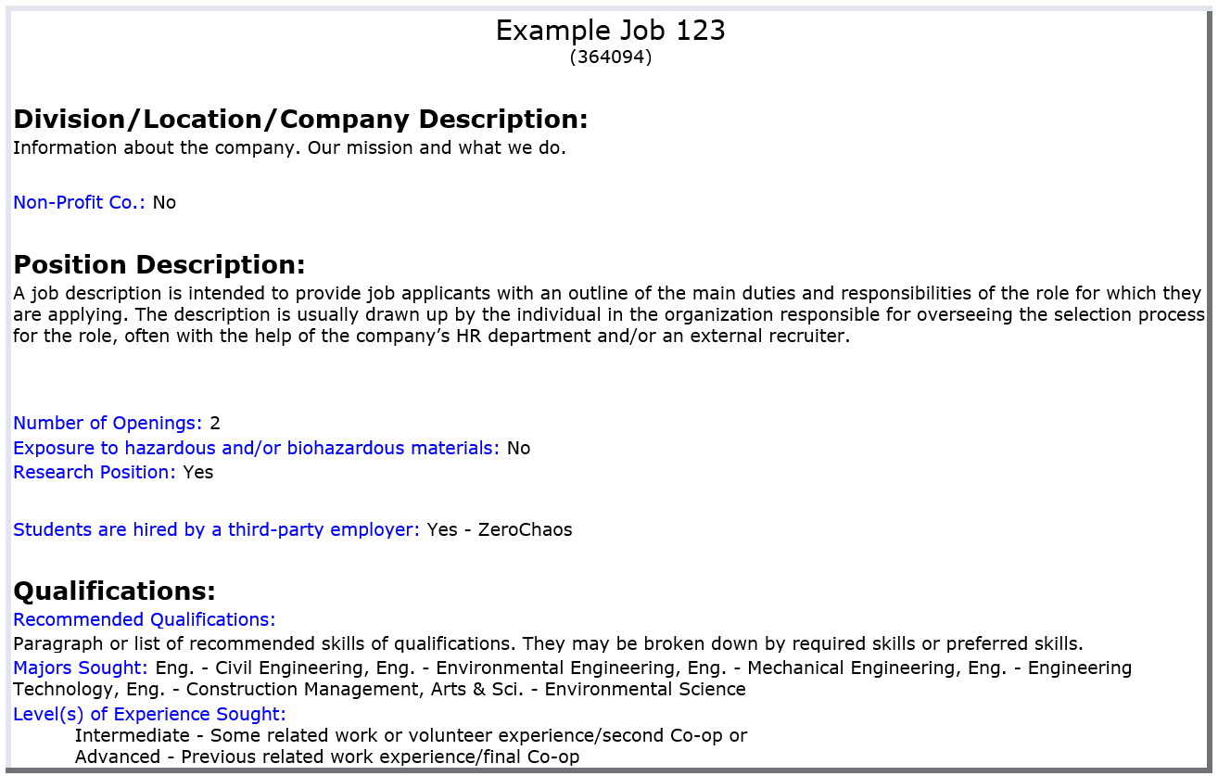
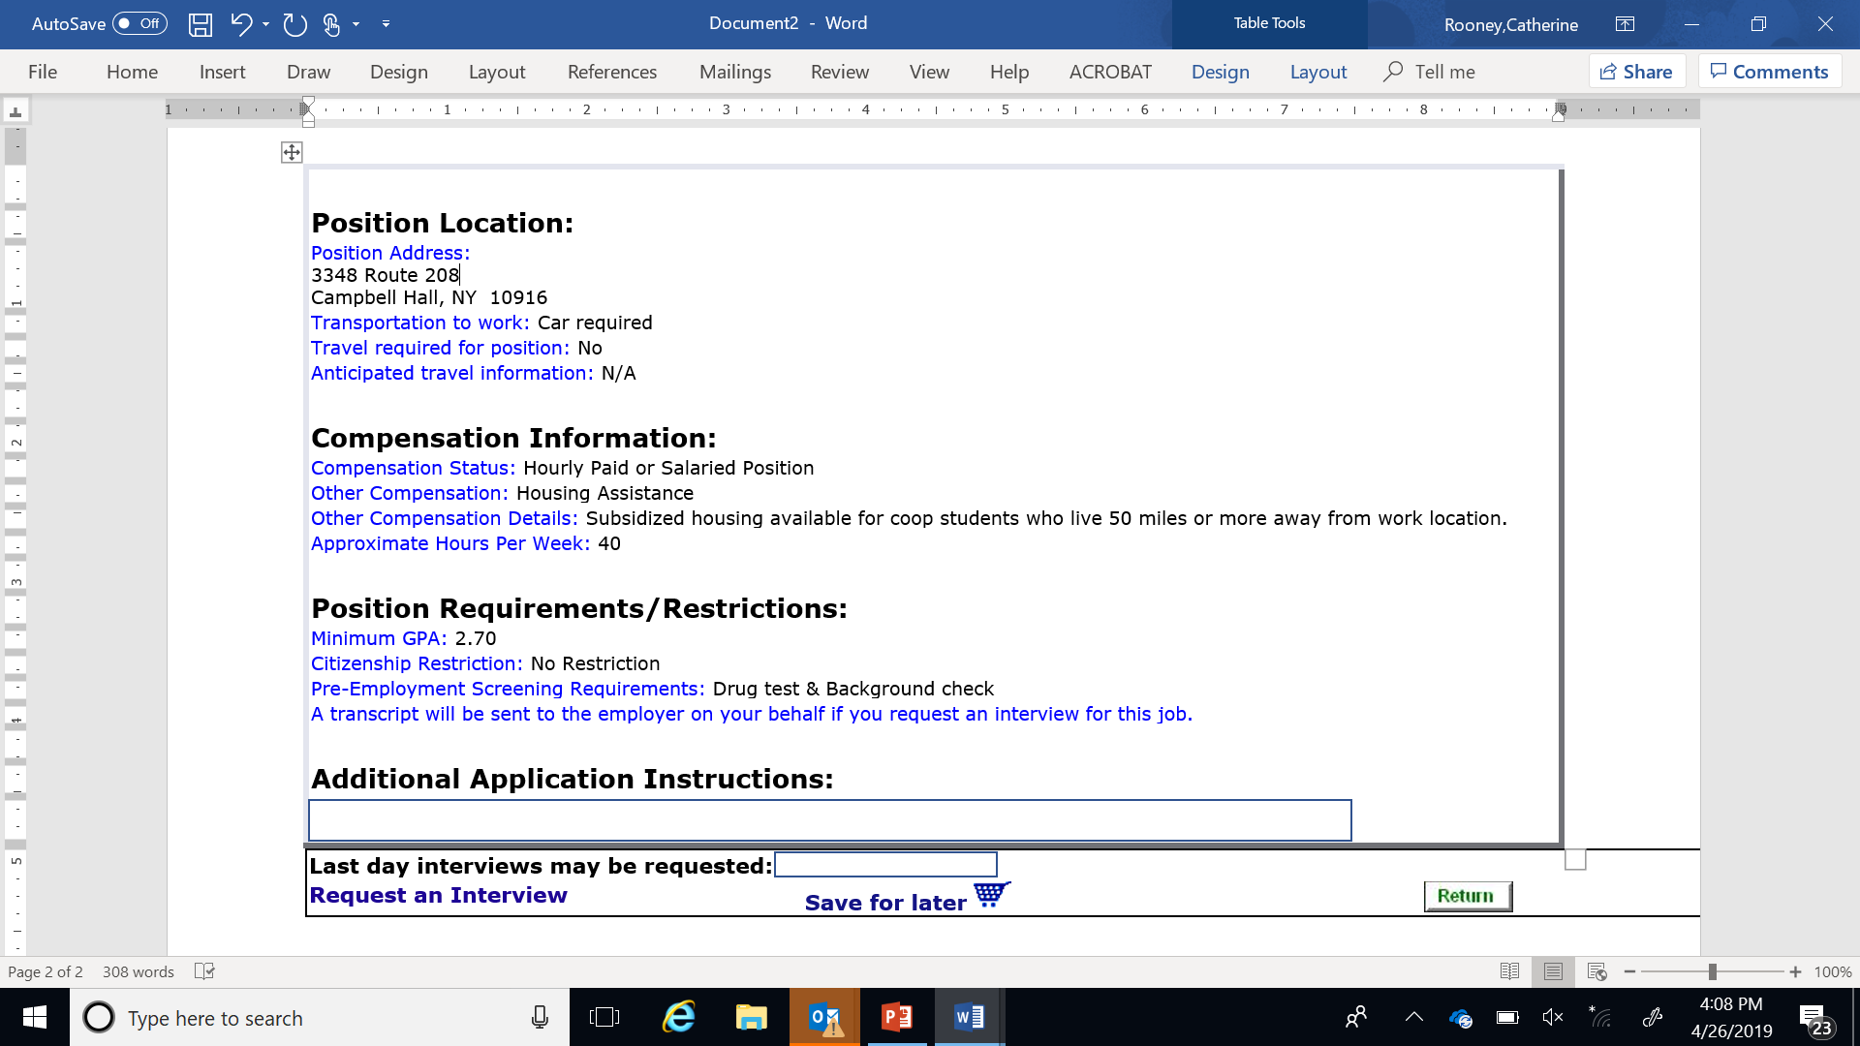
JOB DESCRIPTION SCREEN
Notes:
This is an example of a job description. They are all formatted the same way, the data base is built by the employers. Carefully read and look for the recommended qualifications the employer is seeking in a candidate. For example if the employer states that knowledge of Microsoft Excel is a must and you do not have much experience with it, you should rethink applying for this position or be thinking about how you can get Excel certified before your resume goes out. What are the positions responsibilities? Note the location of the job and determine what your commute will be.

Slide 16
Considerations for your co-op job search strategy
Companies/organizations of interest (large, small, start-ups, for profit, non-profit)
Type of work (hands on, in the field, in the office, behind a computer screen)
Work culture (inclusive, diverse, relaxed, corporate, competitive)
Mission of the company/organization
Population you will work with (children, teens, adults, senior citizens)
Geographic location (will you commute? how long a commute is too long? will you relocate?)
Skills you would like to learn/develop (both hard skills and transferable skills)
Co-op as a “building block”
Notes:
Read through the categories that describe types of companies/work and consider which of these best describe what you will look for in a co-op.
Remember if you have three co-ops scheduled, you might choose to use your co-ops to explore different aspects of work to find a best fit for your long-term career. For example you might decide to work for a large corporation for one co-op, a smaller company for another, and a start-up for your last co-op

Slide 17
Identify your two categories of the “considerations for your job search” that will be important to you.
Discuss with your group, what is one consideration for your job search that is important to you?
Discuss!

Slide 18
Step Three: Assess Your Skills (Gap Analysis)

Slide 19
Assess Your Skills
Personal Gap Analysis
Determine Skills Needed for Job
Assess Your Skills
Identify Gaps
Notes:
A gap analysis will help you analyze skills you need to determine necessary skill development.
Research job descriptions to develop a list of skills needed for the jobs of interest to you
Assess your current skills as they related to the desired qualifications for the position
List the gaps between skills needed and current skill attainment to determine areas of focus

Slide 20



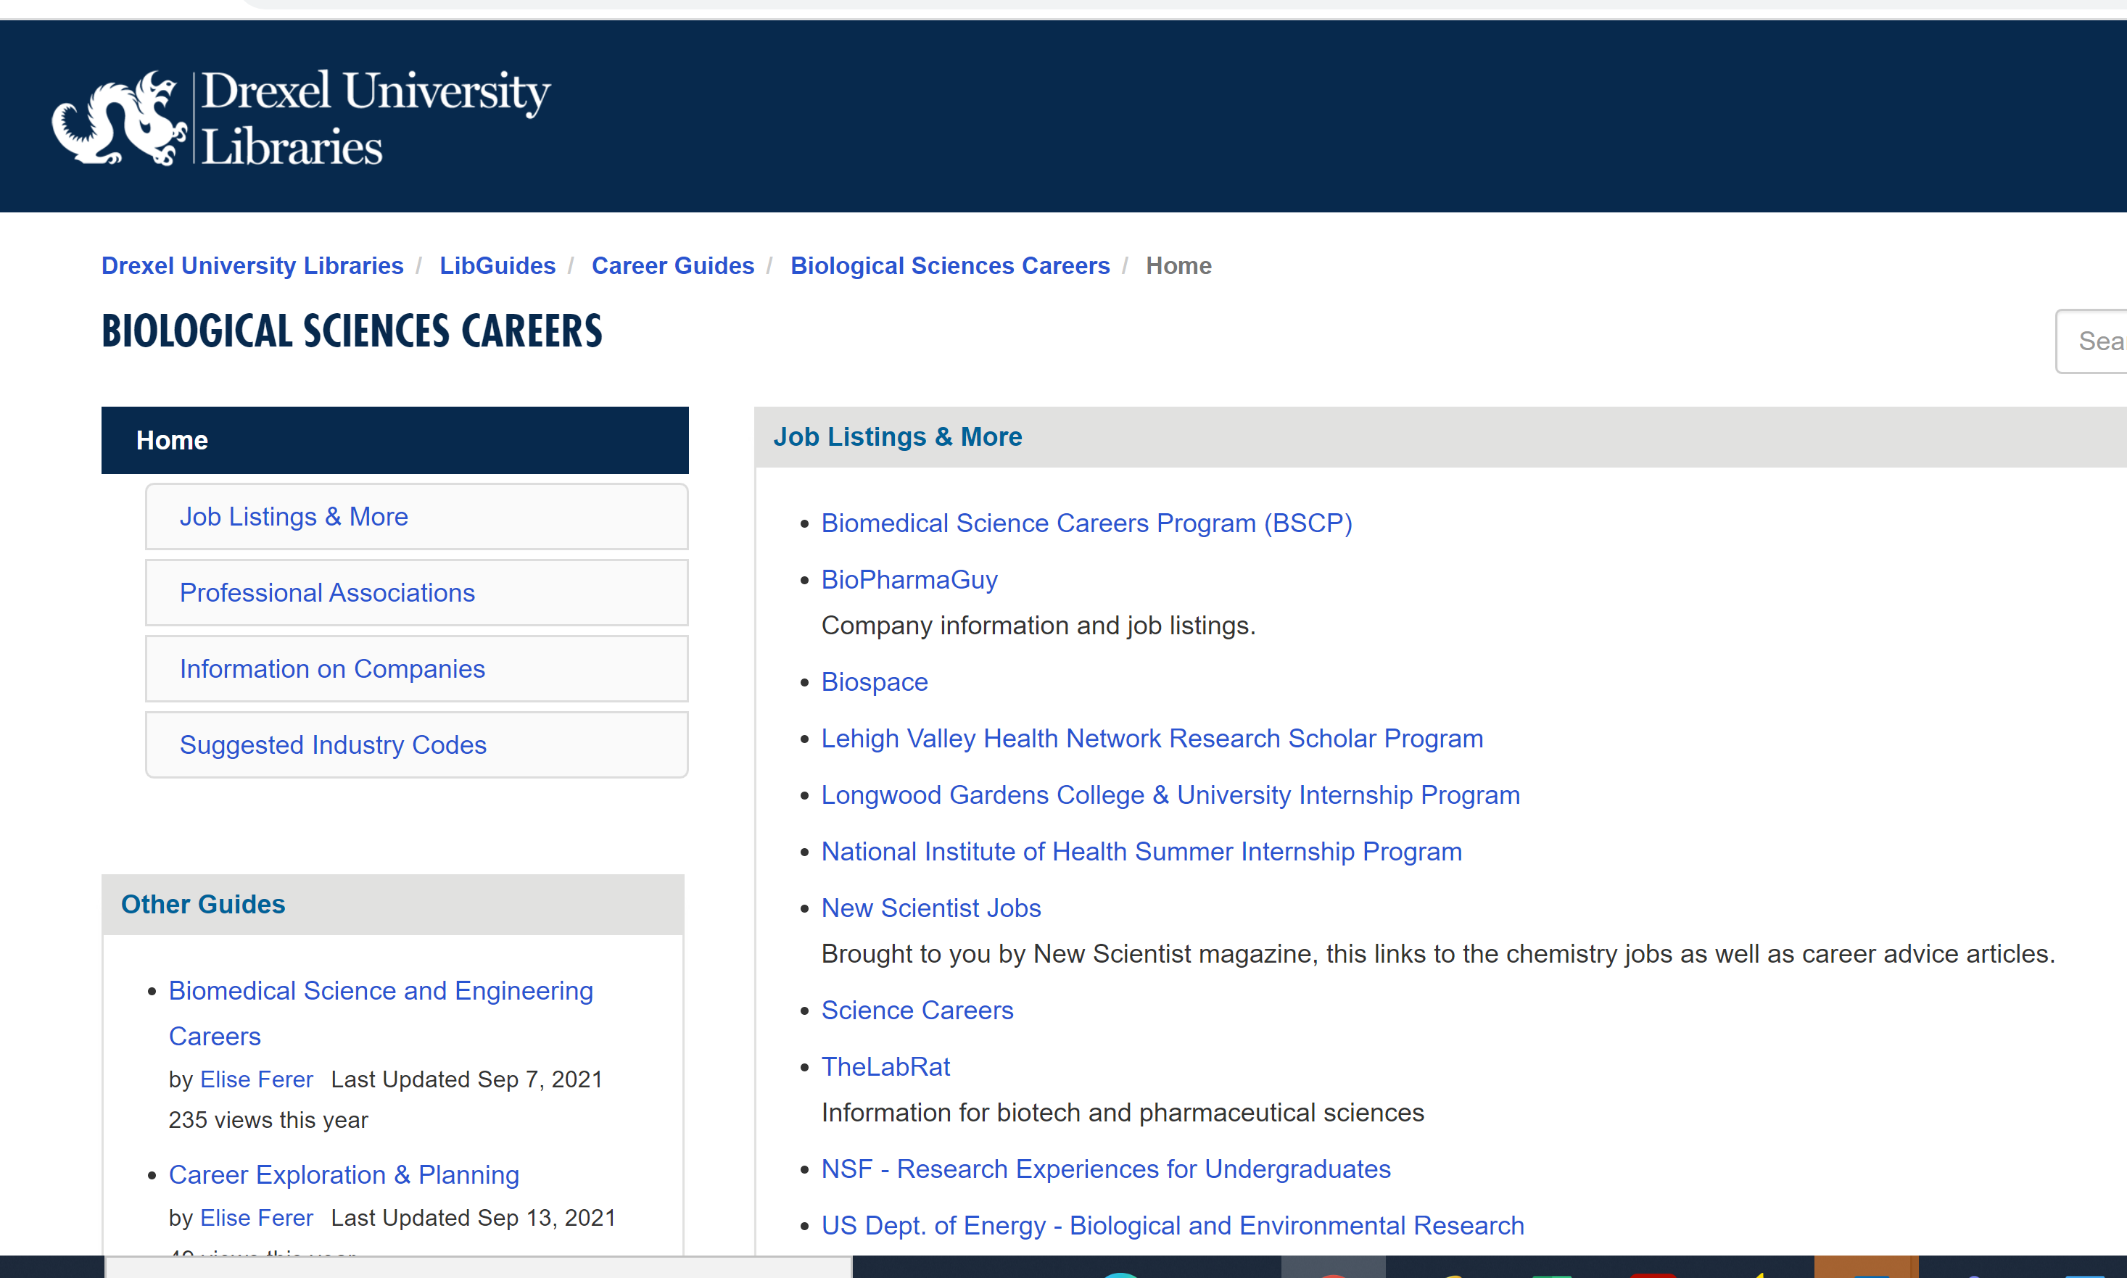

Skill Development Resources
Notes:
These sites are some examples of web based skill development resources and tools available. Once you have conducted a gap analysis, you will set gaols for skill development resources that will be appropriate for you.
The images above are hyperlinked to the resources available. Many are videos or modules that can be completed for certificate attainment or skill development. The career library career guides by major/career fields also offer important information on professional organizations and book/article resources related to any given field.

Slide 21
Step 4: Set Smart Goals to Develop Needed Skills

Slide 22
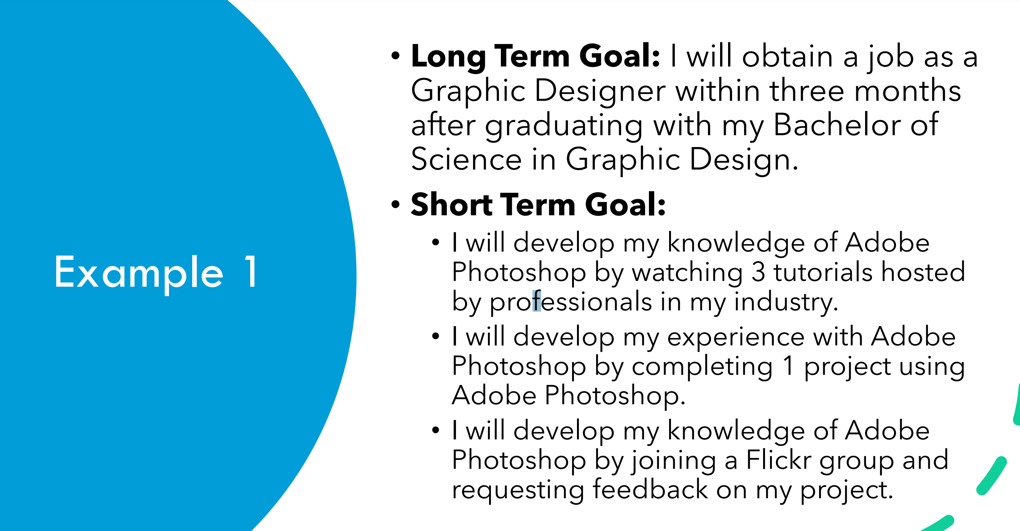
Setting Long and Short-Term Goals for Development
Notes:
Short term goals will enable you to break a larger career related goal into manageable steps that can be completed in smaller increments of available time.

Slide 23
CAREER AND EDUCATIONAL COUNSELING at sTeinbright
Our counselors assist Drexel students Clarify their interests as they relate to majors and career choices
Understand how certain personality factors affect career decision making and selection
Identify career motivators and preferences to make a better fit between personally characteristics and work settings
Students and alumni interested in further details can learn more about these assessments.
Additionally, we offer counseling and guidance regarding career exploration and job search strategies. These topics include résumé/cover letter writing, interviewing skills, networking strategies, job/salary negotiation, transferable skills, and employer expectations.
SCHEDULE A CAREER COUNSELING APPOINTMENT

Slide 24
Workplace Tip: Contribute to an open and inclusive workplace
Eurocentric and Heteronormative Workplace Culture
Research the company
Representation & Self-Care
Recognizing Bias and Microaggressions
Amplify other’s voices
Active Listening
Allyship: The Muse Article:
https://www.themuse.com/advice/what-is-an-ally-7-examples
“Believe others’ experiences. Don’t assume something couldn’t happen just because you haven’t personally experienced it.”
Notes:
Much of career related advice and many aspects of United States workplace culture can be described as Eurocentric and heteronormative, but workplaces have set goals in recent years of being more reflective of the accurate demographics present in the United States
For candidates who want to ensure their workplace is inclusive and diverse, researching the company. Do your research of the company and website to ensure it is a place that values diversity, equity and inclusion.
The employer may lean on students or employees who represent a demographic that is different than their own for their thoughts, opinions about the workplace culture. Be mindful of your own self care if this is a situation you find yourself in.
Be an intentional alley in the workplace. Review the article and think of ways you will be an alley to those you work with.

Slide 25
WHAT IS DEIB?
The existence of the differences that make us uniquely who we are. This includes the personal, internal, external and organizational identities outlined on the diversity wheel.
The process by which we aim to achieve fairness through reallocation of University resources for the benefit of everyone as we acknowledge that the default system of allocation supports historical and/or systemic disadvantages, bias and discrimination
Diversity
Equity
Inclusion
Belonging
The active, intentional and ongoing engagement with diversity – in the curriculum, co-curriculum and within communities in ways that increase awareness and understanding of the nuanced ways individuals interact with and within systems and institutions. This is a verb.
The sense of psychological safety that affords each member of the Drexel community to be their authentic self, without fear of judgement, while actively and meaningfully contributing to the campus community.
Notes:
We tend to use DEI interchangeably and they are not.
Diversity is quantifiable, countable, about the numbers. When companies talk about diversity efforts, this is what they are talking about. The problem is focusing on just this is one leg of a three legged stool.
Equity is allocation of resources in a fair way. Distinction between equal and fair is important.
Inclusion is the verb of these things, active, intentional and ongoing engagement piece. The diversity doesn’t matter if there isn’t inclusion and if the same people are always talking, influencing decisions.
Belonging is what you get if doing the other pieces well. If you don’t get belonging, that feeling, you don’t get the benefits of doing the others.

Slide 26
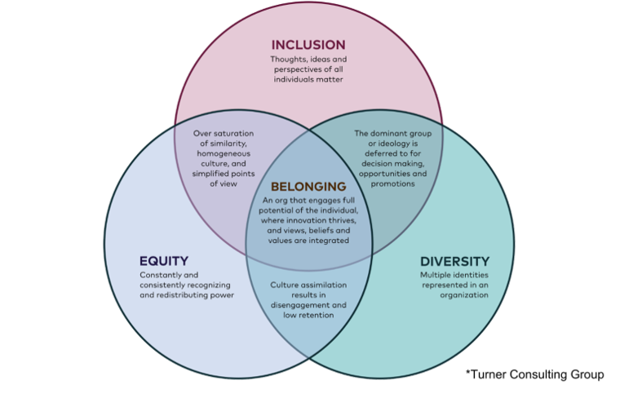
WHAT DOES THIS LOOK LIKE AT DREXEL OR OTHER ORGANIZATIONS?
Notes:
Diagram from a consulting firm that helps businesses visualize the impact of these concepts. Consider what you have if just two of these circles overlap.
Question: Why is it important to have these at work? Consider in terms of Drexel, co-op, a student org you are a part of? Could also consider challenges/considerations, time, money, commitment across organization, stakeholder buy-in.

Slide 27
WHY SHOULD WE STRIVE FOR A SENSE OF BELONGING AT WORK?
A high sense of belonging is linked to a 56% increase in job performance, a 50% drop in turnover risk, and a 75% reduction in sick days ¹.
40% of people say they feel isolated at work and the result has been lower organizational commitment and engagement ¹.
Belonging can lead to 2x more employee raises and 18x more employee promotions ².
Feeling like we need to intentionally hide, cover or leave a particular identity in order to fit in with everyone else sacrifices our authenticity and sense of belonging ³.
¹ Carr, E., Reece, A., Rosen Kellermna, G., & Robichaux, A. (2019, March 16). The value of belonging at work. Harvard Business Review. https://hbr.org/2019/12/the-value-of-belonging-at-work
² Bordeux, C. & Lewis, S. (2021, September 23). Designing the workforce experience with the human at the center. Deloitte. https://www2.deloitte.com/us/en/blog/human-capital-blog/2021/human-centered-workforce-experience.html
³ Henley, D. (2022, March 20). The secret to creating a sense of belonging at work. Forbes. https://www.forbes.com/sites/dedehenley/2022/03/20/the-secret-to-creating-a-sense-of-belonging-at-work/?sh=77a167377a88
Notes:
If you have all aspects of DEI working together and achieve belonging, it can have these benefits.
Conversations around productivity, quiet quitting,

Slide 28
HOW TO PROMOTE BELONGING AT YOUR WORKPLACE
Mirror the language that someone uses to describe their own identity.
Encourage participation from everyone. When someone isn’t participating, take notice and work to support them.
Establish ahead of time what behaviors, skills and outcomes demonstrate proficiency and success. This mitigates bias in evaluating skills, efforts and outcomes.
Practice effective allyship
Acknowledge expertise and skill. People with minoritized identities often find their skills are regularly questioned and held to higher standards. Be aware of these biases and recognize when someone’s skill or expertise is being unduly or unevenly questioned.
Get to know people. Show genuine curiosity about their lives and work so that interactions that may have just been transactional become relational.
Amplify the voices of (WHILE GIVING CREDIT TO) people with minoritized identities.
Notes:
How can you get the benefits from previous slide, and how can you decrease negative effects of not having DEIB.
Quick definition of allyship: Using your power to empower others

Slide 29
If you experience discrimination, harassment or bias at your co-op...
EIC Is Here FOR YOU.
Reach out to your co-op instructor or directly to the Office of Institutional Equity and Inclusive Culture via any of the contact information on the last slide.

Slide 30






HOW TO PROMOTE BELONGING AT YOUR WORKPLACE
EIC@drexel.edu
215.895.1405
https://drexel.edu/equity-inclusive-culture/
James e. marks intercultural center
3225 Arch Street, Suite 011
Philadelphia, Pa 19104
To submit a report:
In person office hours:
Tuesday-Thursday, 8:30 am – 5:00 pm
Online at https://drexel.edu/equity-inclusive-culture/I
n person during our office hours
Over the phone M-F, 9:00 am – 5:00 pm

Slide 31
Access the ES&P Archives through the Co-op & Career Tab in Drexel One
Filter on your major to begin to search the archives for job descriptions students in your major have worked
Review the Description and Qualifications to consider:
Fit with your Interests
Assessment of your skills relevant to qualification
In-Class Work

Slide 32
Resume was due today!
Default resume in system must be the one you want graded!
Due Next Week (By Class Time-Week 5)
Assignment One (10% of your grade): Job Description from the ES&P Archives
The assignment submission link is in week 4’s course content folder, NOT THE ASSIGNMENT TAB.
Navigate to the Co-op and Career Tab in Drexel One
Select the link to access the "ES&P Archvies“
Use the search tool to find one job description of interest, and submit the job description through blackboard for credit by just copying and pasting the description.

